Slide 1
Infrastructure As Remote Code Execution

Slide 2
AGENDA
Introductions
Lab setup
Introduction to Terraform
Lab 1
Break

Slide 3

TEAM
Ken Toler
President – Asgard Security
Founder / Co-host for R2DSO
vCISOing
Web3 Security Advocate
Passionate about transforming software security programs
🎤 Loves Karaoke

Slide 4

TEAM
Michael McCabe
CEO – Cloud Security Partners
R2DSO Co-host
Passionate about IAC
Does cloud security things
Is horrified by the next slide

Slide 5

WHO ARE YOU?
Introductions

Slide 6
WHY THIS COURSE?
Infrastructure Security is becoming Application Security
Infrastructure as code is main method of deployment
Opportunity to inject security
Must be aware of potential security issues
Security through code is the future

Slide 7
WHAT TO DO
Ask Questions
Interact and experiment
Work with others
Learn together

Slide 8
SETUP
AWS
TERRAFORM
AWS CLI
Create AWS Account
Add Keypair
Name Keypair
Download Privkey
Change Permissions
Verify Console Access
Download Terraform
Install Terraform
Verify installation
Download AWS CLI Installer
Run Installation Command
Configure AWS Credentials
Test AWS CLI Installation
(Optional) Update AWS CLI

Slide 9
WHAT YOU WILL LEARN
Terraform Basics
Semgrep Basics
Minor Exploitation
Lateral Movement in a Cloud Environment
How to misconfigure Infrastructure

Slide 10
WHEN YOU LEAVE YOU WILL HAVE
Understood the basics of Terraform Deployments
Deployed a Terraform Plan in AWS
Exploited a misconfiguration
Created a reverse shell in a cloud environment

Slide 11
LAB SETUP
Wifi info:
WIFI: MSFTGUEST
Password: msevent369wd
https://github.com/r2dso/terra-fied - http://bit.ly/46OO36b
git clone git@github.com:r2dso/terra-fied.git
cd terra-fied/basic_terraform
terraform init
terraform plan
What’s required?
AWS Access
Terraform installed
Code Editor

Slide 12
Introduction To Terraform

Slide 13

Introduction To Terraform
Configuration Management vs Infrastructure as Code
Terraform is stateful and declarative
Ansible, as an example is stateless and imperative
Think about how you order a sandwich…
Notes:
- Sandwich analogy
- Give me a ham sandwich
- I want two slices of bread, cheese, tomato, and ham

Slide 14


Foundation

Slide 15
Foundation
Provider
Backend
Determines resource types and data sources for your infrastructure
Integrates with Provider APIs (AWS, GCP, Azure, etc.)
Defines where terraform stores STATE files
Default backend is `local`
Careful with credentials and sensitive data
Initialization ( `init` )

Slide 16
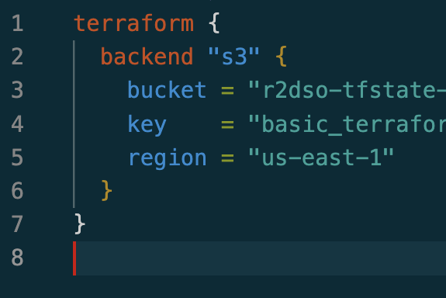
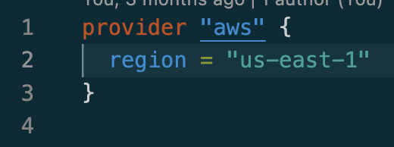
Foundation
Provider
Backend

Slide 17
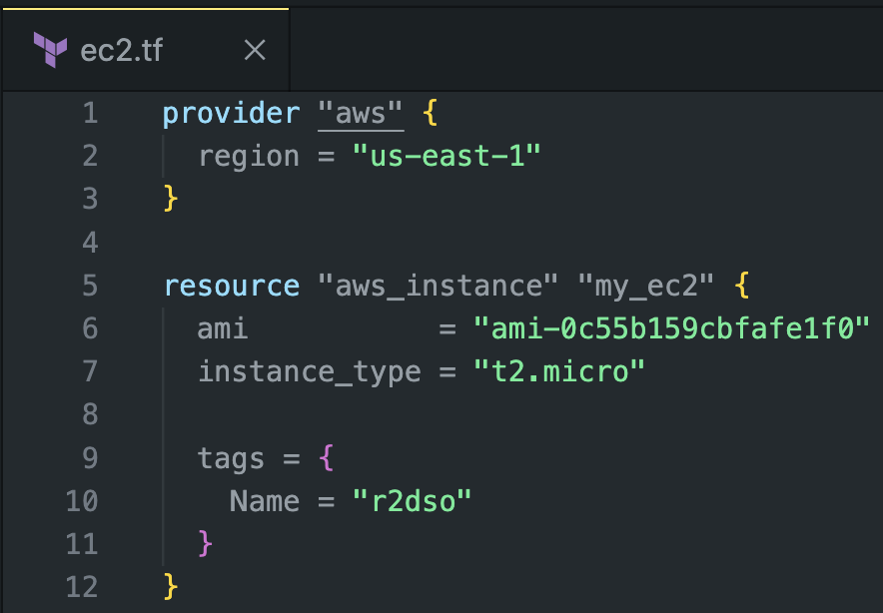
Providers
What do they do?
Notes:
Talk through the lab provider setup
https://github.com/r2dso/terra-fied/blob/main/basic_terraform/provider.tf

Slide 18
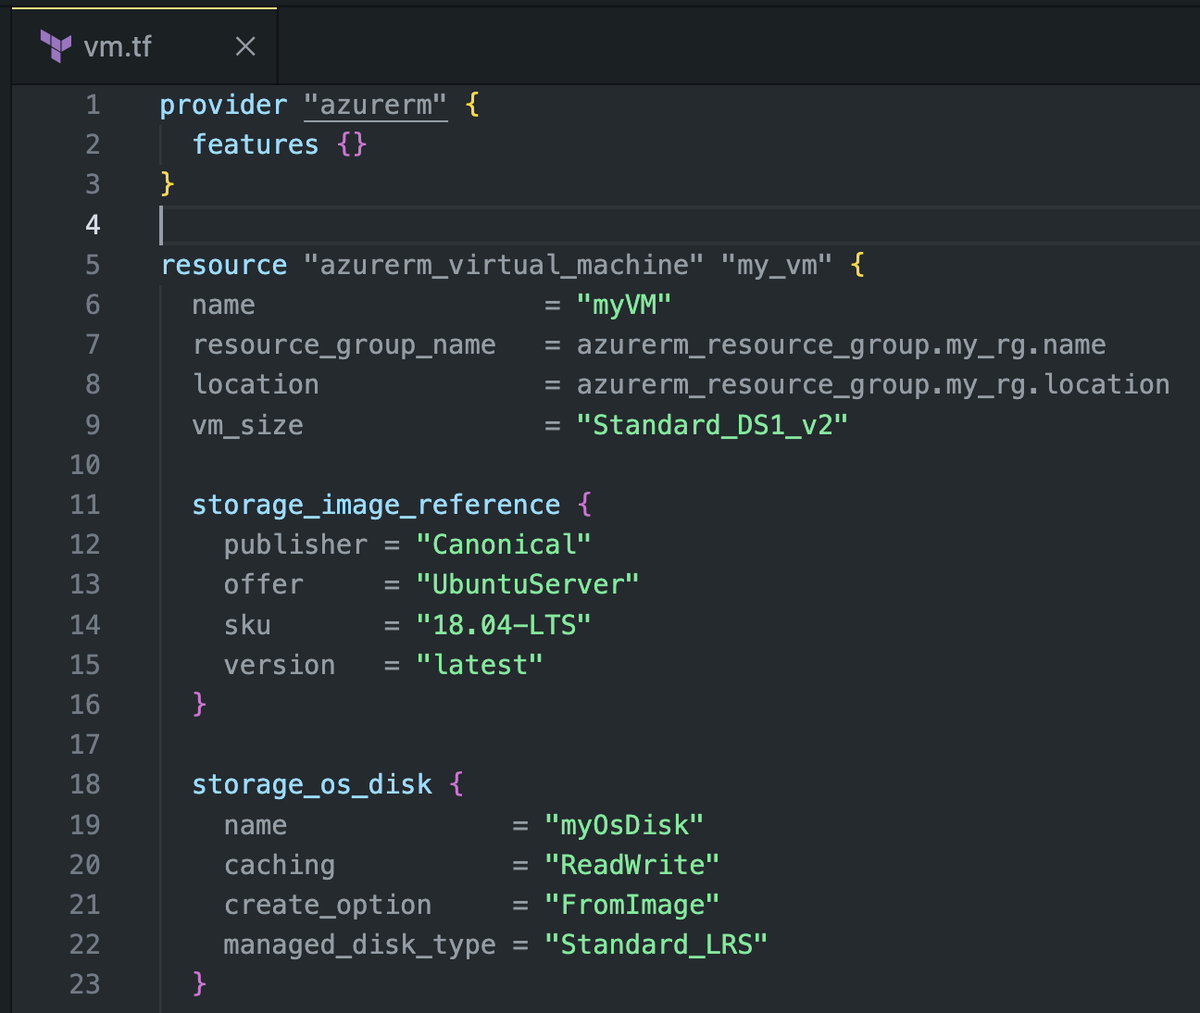
Providers

Slide 19
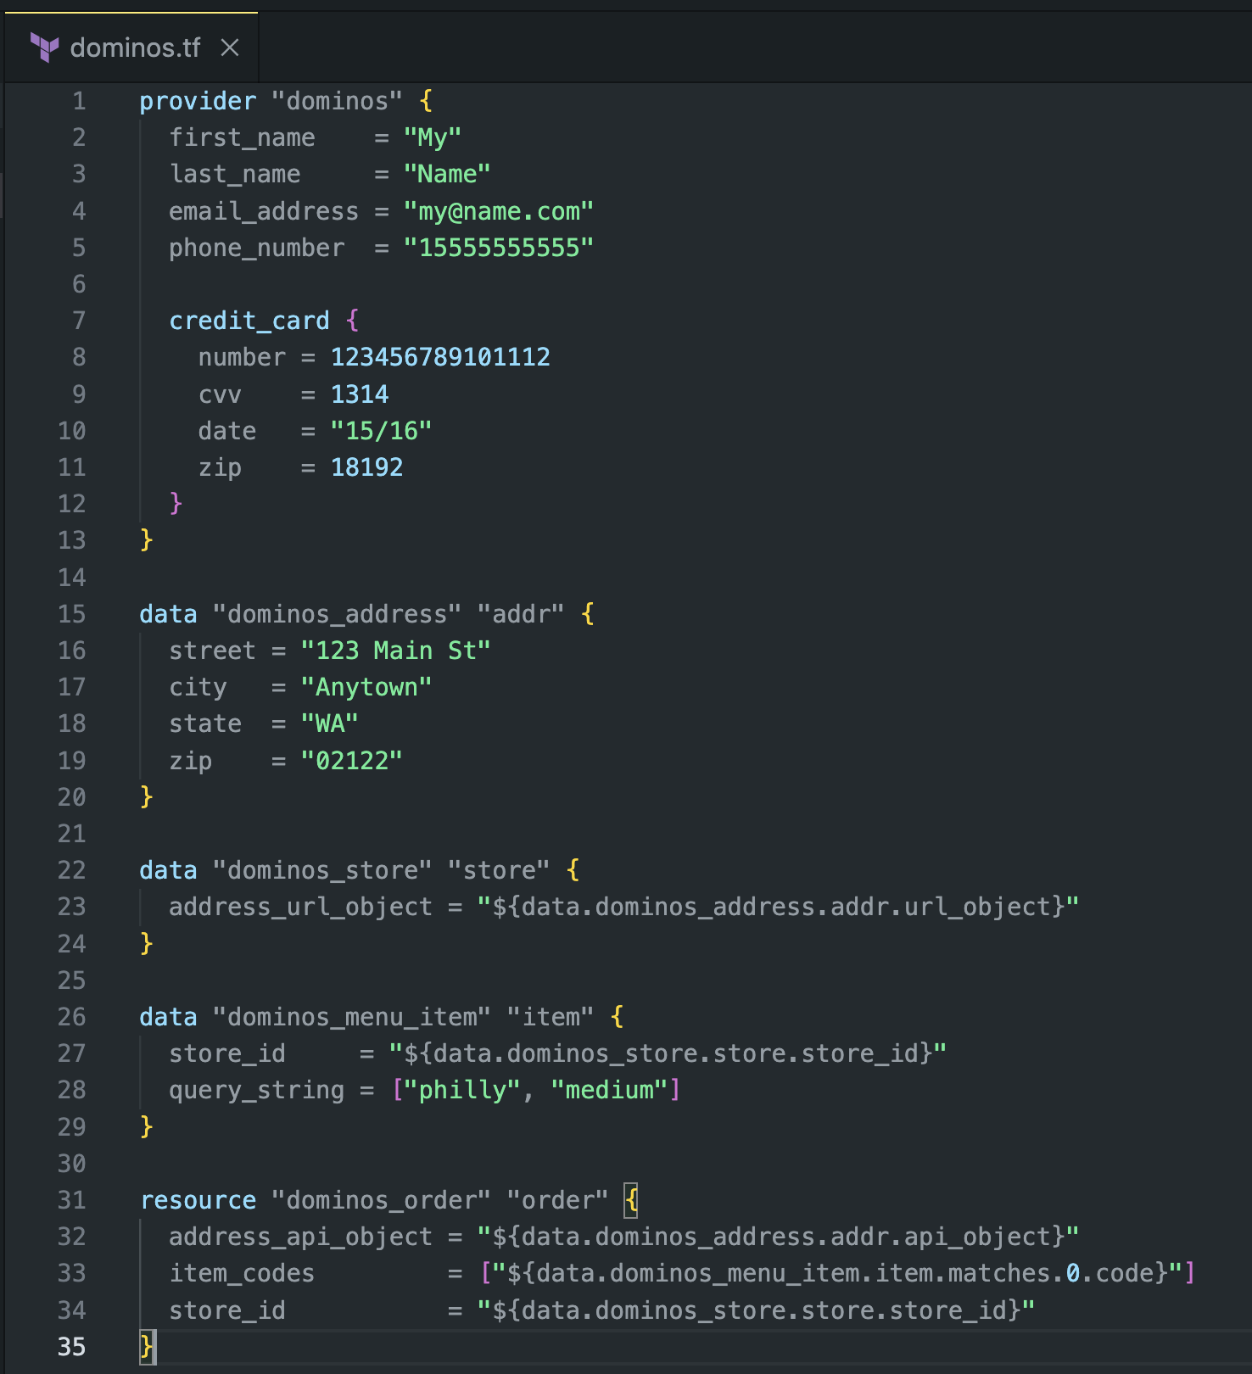
Providers
Notes:
https://github.com/cappyzawa/terraform-provider-christmas-tree
https://github.com/conradludgate/terraform-provider-spotify
https://ndmckinley.github.io/terraform-provider-dominos/

Slide 20
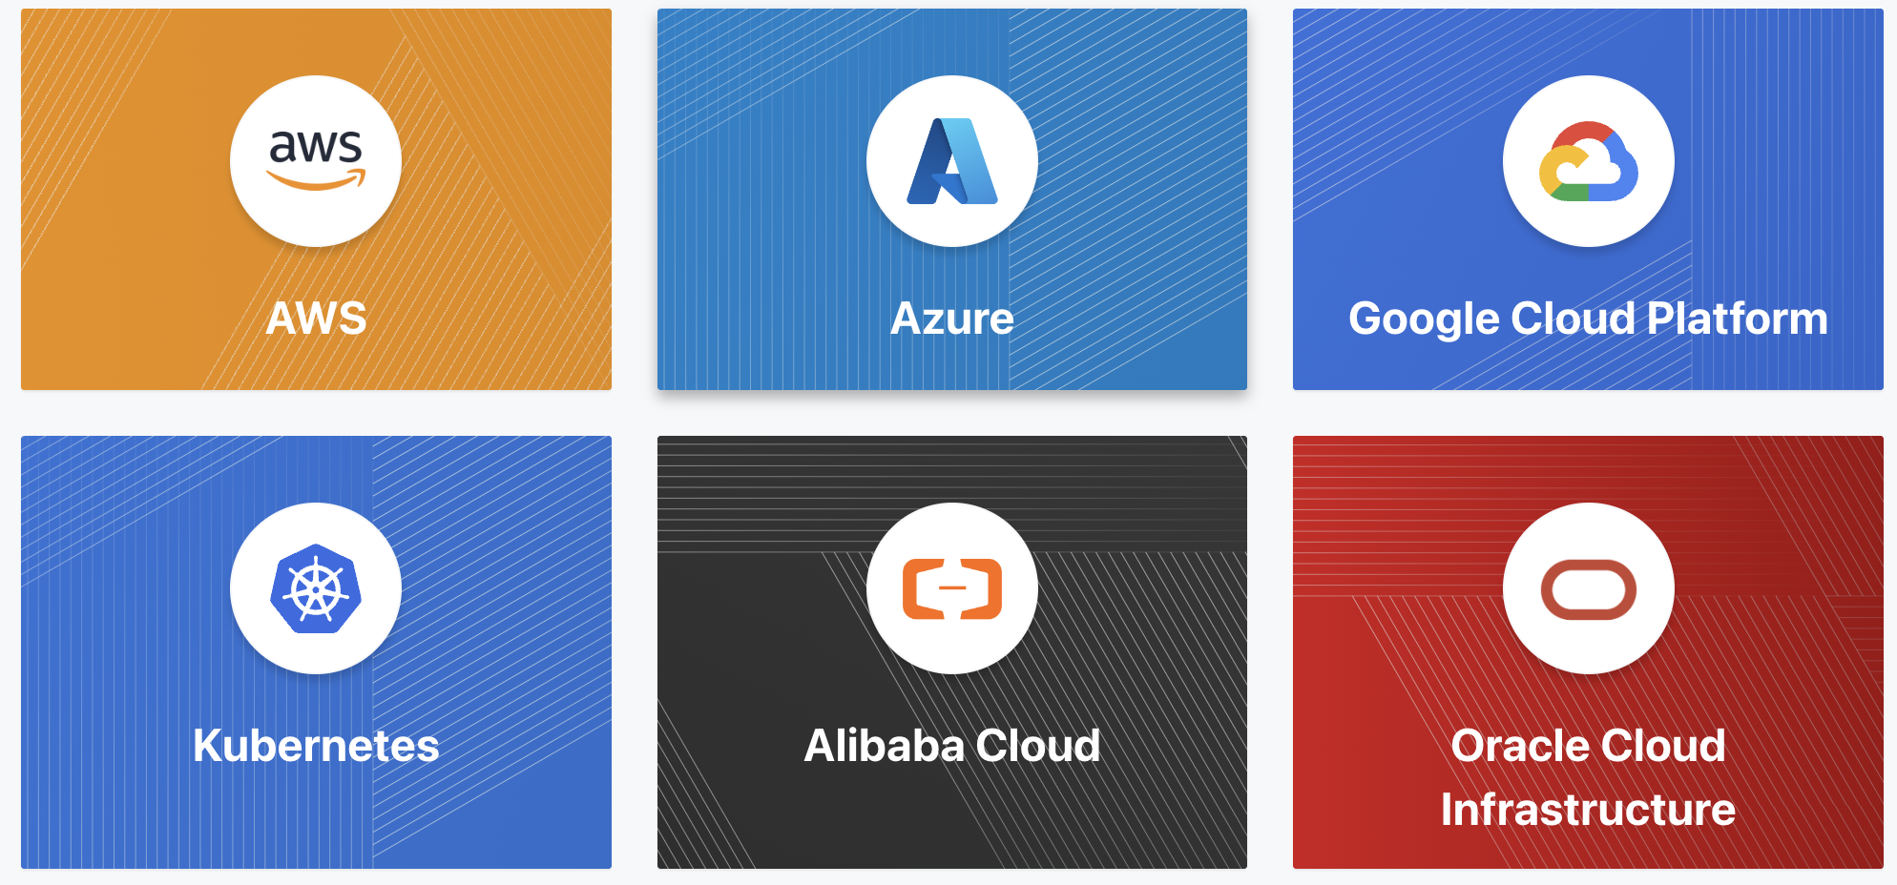
Providers
“Terraform relies on plugins called providers to interact with cloud providers, SaaS providers, and other APIs.”

Slide 21
Quick walkthrough

Slide 22
Backend
A backend defines where Terraform stores its state data files.
Many options for backends, local, S3, blob, Postgres
Notes:
Show the backend configuration and the state file stored in S3
https://github.com/r2dso/terra-fied/blob/main/basic_terraform/backend.tf

Slide 23
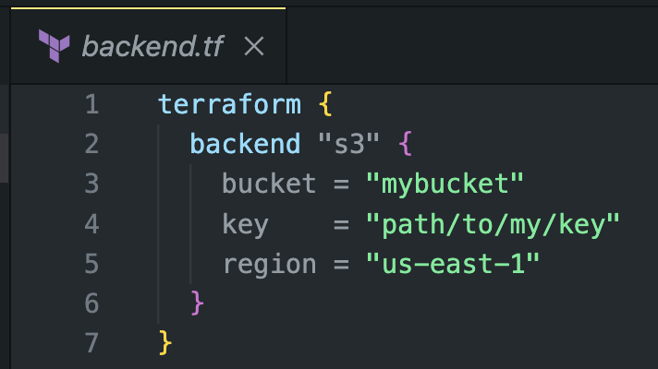
Backend

Slide 24
LAB 0
Run lab_setup
Set up a remote backend.tf
Locate lab_setup folder
Run terraform init
Run terraform plan
Run terraform apply

Slide 25
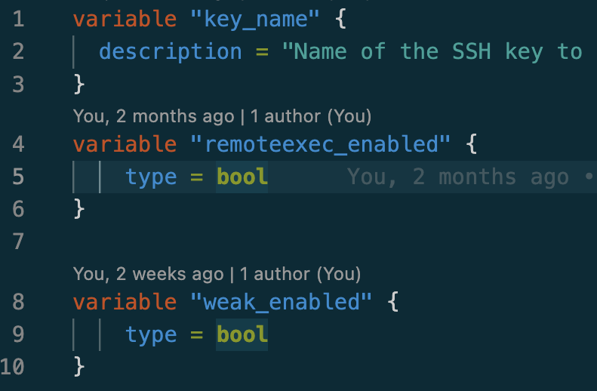
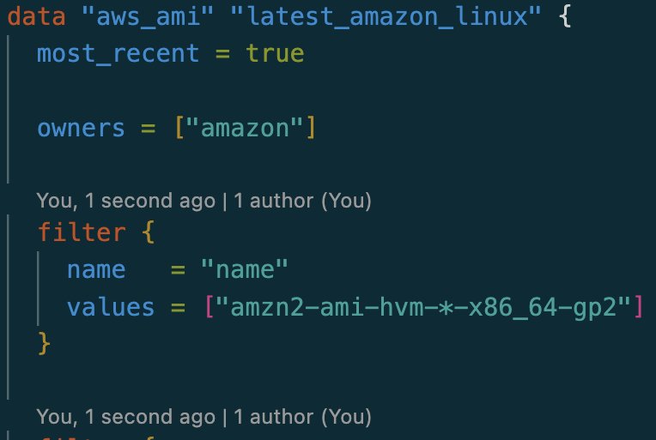
Foundation
Variables
Data

Slide 26
Variables
“Input variables let you customize aspects of Terraform modules without altering the module's own source code. This functionality allows you to share modules across different Terraform configurations, making your module composable and reusable.”

Slide 27
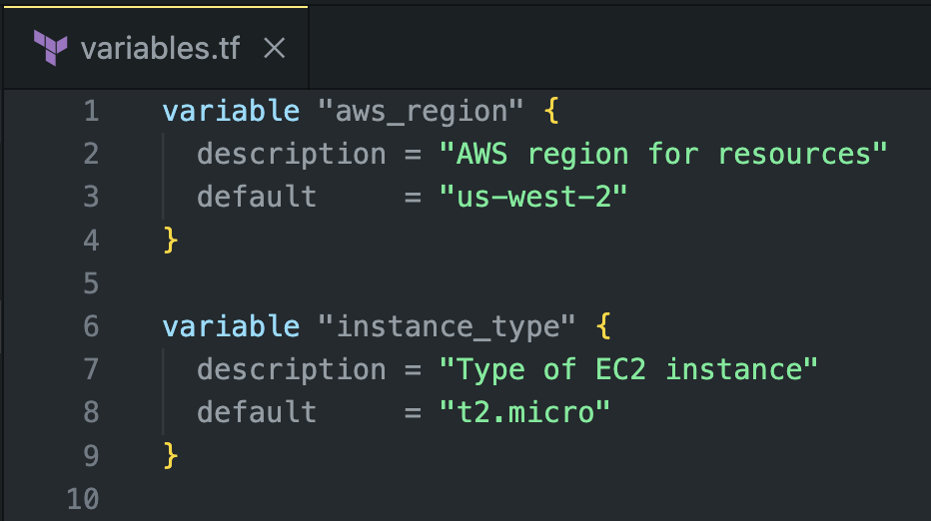
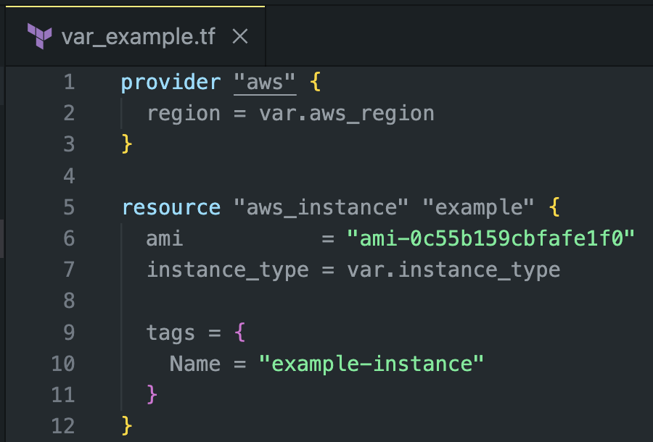
Variables

Slide 28
Data
“Data sources allow Terraform to use information defined outside of Terraform, defined by another separate Terraform configuration, or modified by functions.”
Notes:
https://developer.hashicorp.com/terraform/language/data-sources

Slide 29
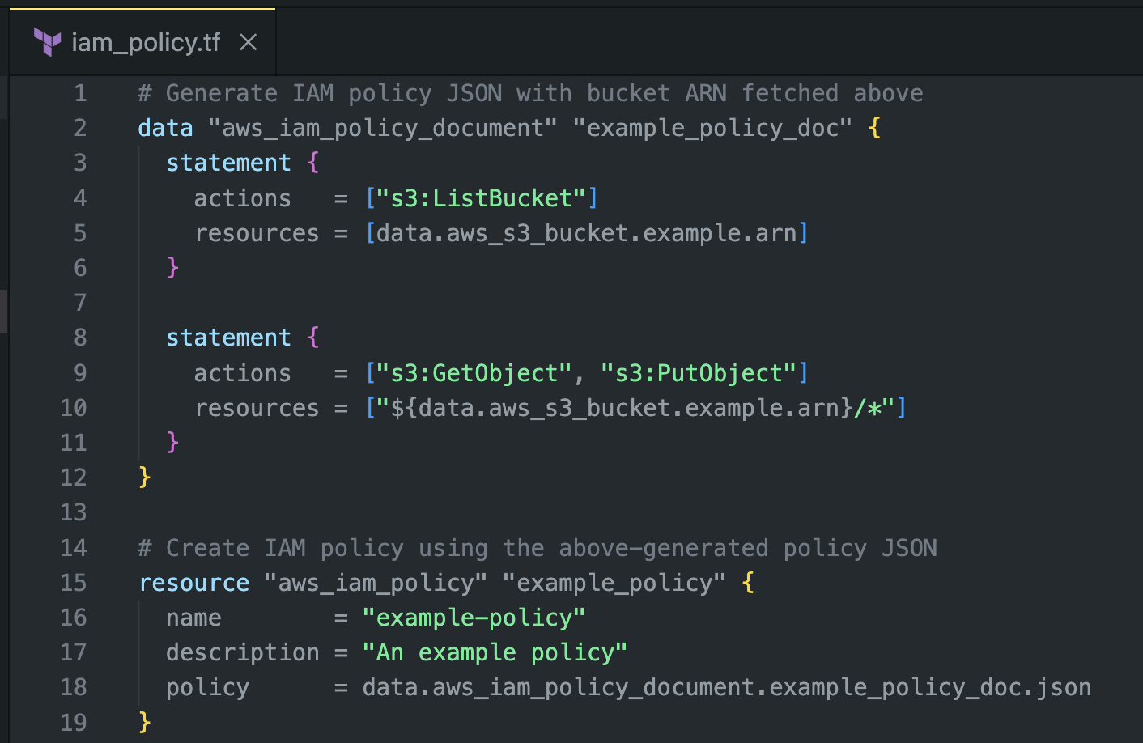
Data
“Data sources allow Terraform to use information defined outside of Terraform, defined by another separate Terraform configuration, or modified by functions.”
Notes:
https://developer.hashicorp.com/terraform/language/data-sources

Slide 30
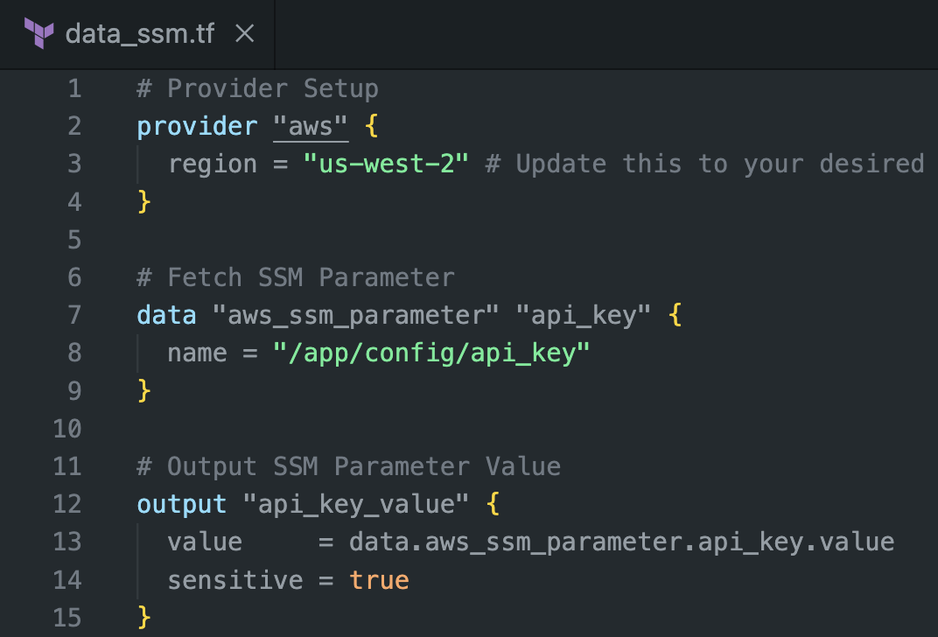
Data
Notes:
https://developer.hashicorp.com/terraform/language/data-sources

Slide 31
BREAK
10 MINUTES!!!

Slide 32
Foundation Bookends
Resource
Output
The fundamental building block
Meta-arguments
depends_on, count, for_each, provider, lifecycle, provisioner
Timeouts
Create, Destroy, Update in-place, Destroy and Recreate
Accessing Attributes
Check Conditions
Provide information on Run
Sensitive Attribute

Slide 33
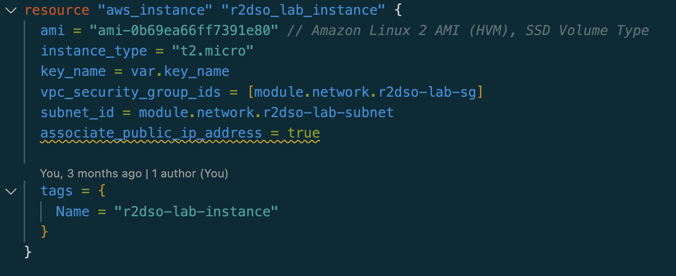
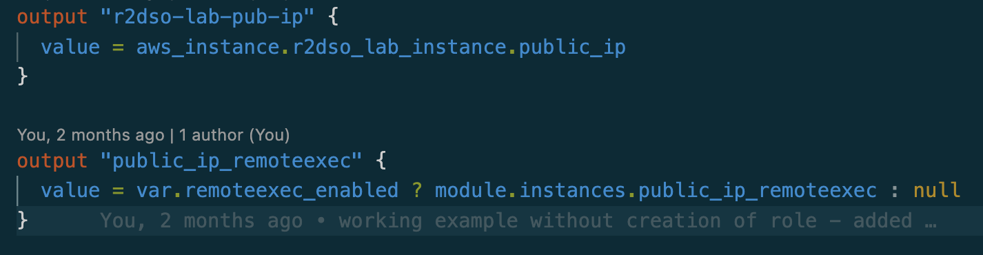
Resources & Output

Slide 34
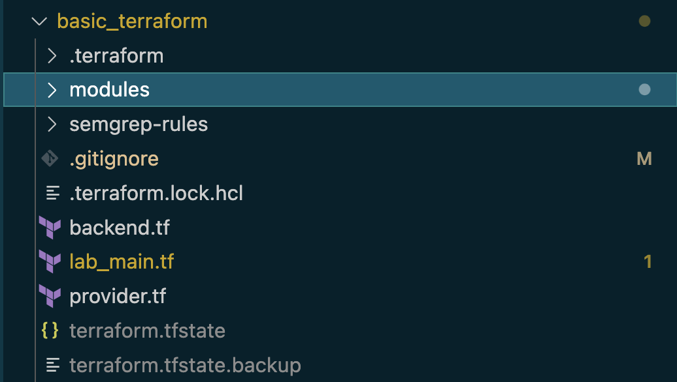
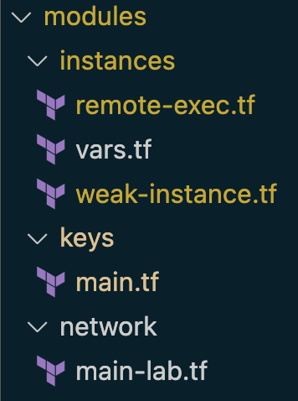
Terraform File Structure
Single/Multiple Files
Folder Structure
Files

Slide 35
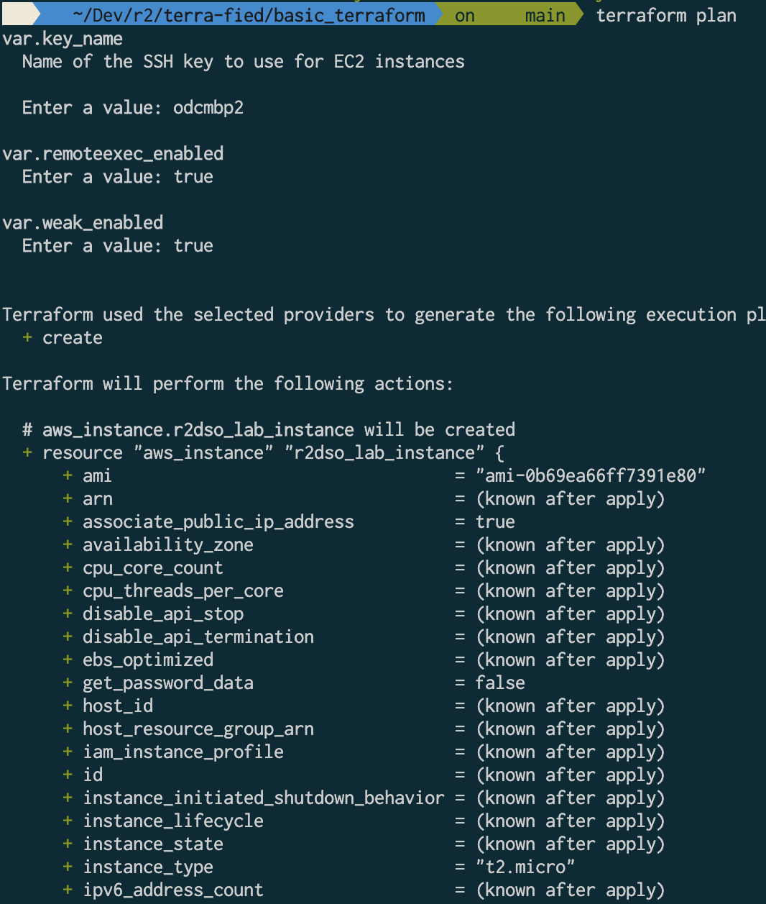
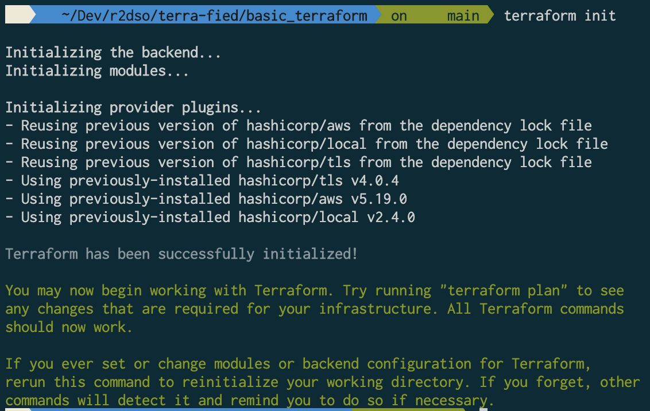
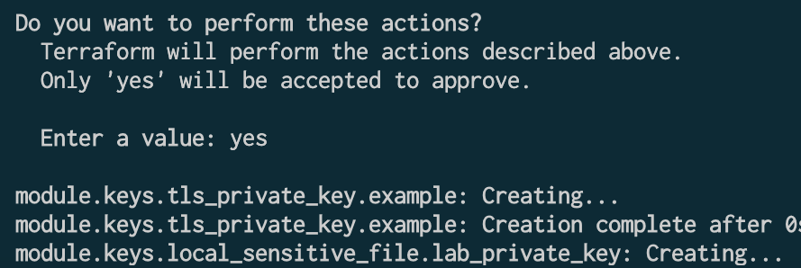
COMMANDS
Init
Plan
Apply
Destroy

Slide 36
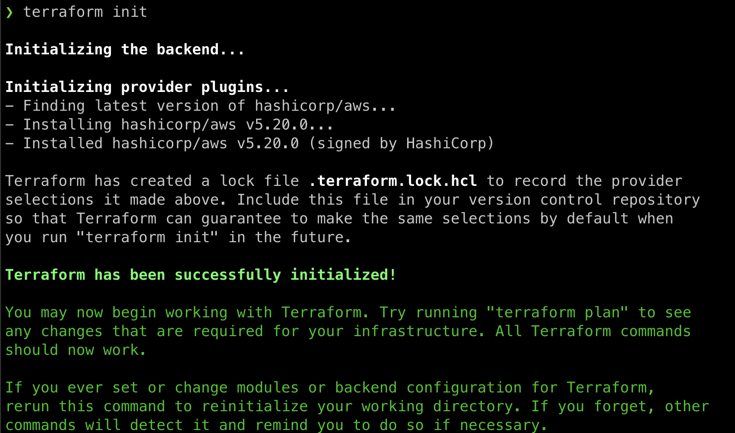
COMMANDS
Init
Initializations the Terraform workspace
Downloads the providers
Verifies the providers
Initializes the backend

Slide 37
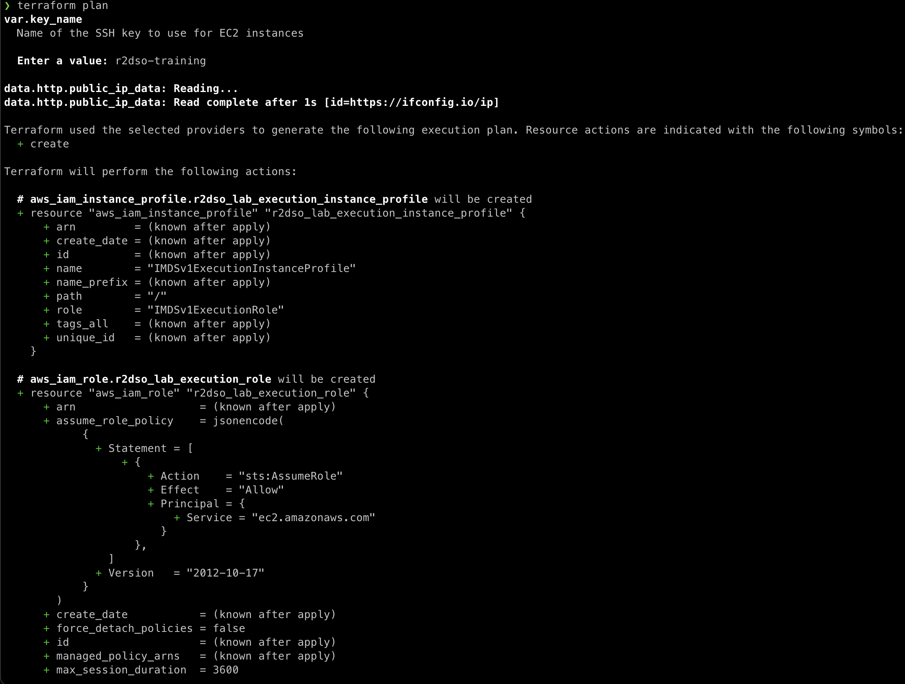
COMMANDS
Plan
Reads state
Determines delta
Propose changes to state

Slide 38
LAB 1
Examine the basic_lab plan
Review Components
modules
data
iam
main
Run Plan
Show in AWS Console
SSH for access

Slide 39
Example – Simple Deployment
terraform plan (no variables)
Examine backend
Examine state
Identify vulnerabilities in simple deployment

Slide 40
TERRAFORM STATE
“Terraform must store state about your managed infrastructure and configuration. This state is used by Terraform to map real world resources to your configuration, keep track of metadata, and to improve performance for large infrastructures.”

Slide 41
Data Exfiltration
Variables and Resource Info
Data
Sensitive Values
Remote
Local
Credentials
Metadata
Tags
External exposure of remote data
Provider data
…

Slide 42
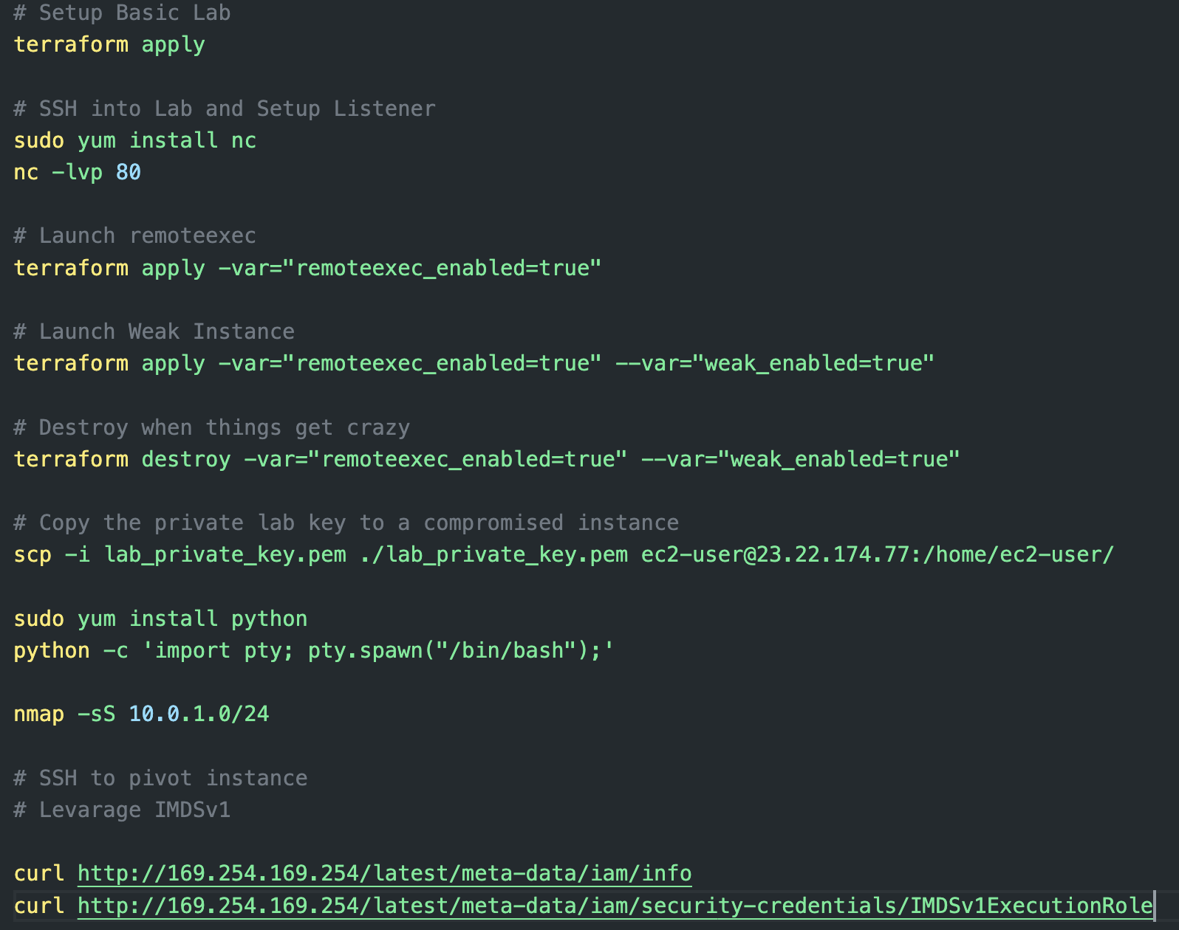
LAB 2 – remote exec
Notes:
https://gist.github.com/mccabe615/c5e631fa766697eaaf98020bc1ee10ba

Slide 43
LAB 2 – remote exec
Notes:
https://gist.github.com/mccabe615/c5e631fa766697eaaf98020bc1ee10ba

Slide 44
LAB 2 – remote exec
Notes:
https://gist.github.com/mccabe615/c5e631fa766697eaaf98020bc1ee10ba

Slide 45
LAB 3 – Lateral Movement
Notes:
https://gist.github.com/mccabe615/c5e631fa766697eaaf98020bc1ee10ba

Slide 46
LAB 4 – Privilege Escalation
Notes:
https://gist.github.com/mccabe615/c5e631fa766697eaaf98020bc1ee10ba

Slide 47
Reviewing the project
What are some areas of weakness?
Are there any vulnerabilities in the codebase?
What issues would it introduce?

Slide 48
Pillars of Defense
SAST
Policy as Code
Monitoring
Tooling that scans IaC before the plan / apply
Runs on raw code
Runs on your configuration
Runs on output of the plan
Provides test coverage for your IaC
Enforces policies for an organization
Applied after the plan and before deployment
Runs after deployment
Enforces policies
Last defense
Incident Response

Slide 49
SAST in Infra as Code
Scanning for flaws in the code
Looking for common weaknesses and low-hanging fruit
Custom rules for your environment
Pre-deployment protection
Non-dynamic

Slide 50
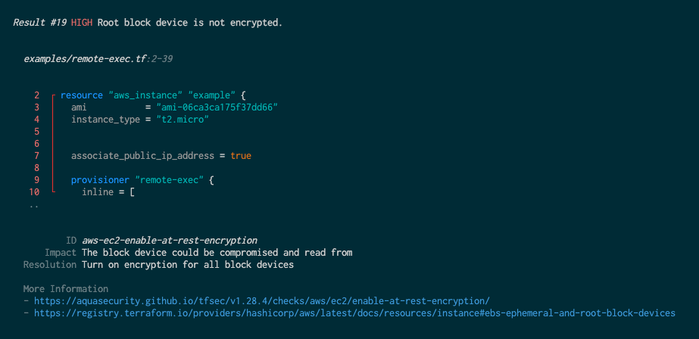
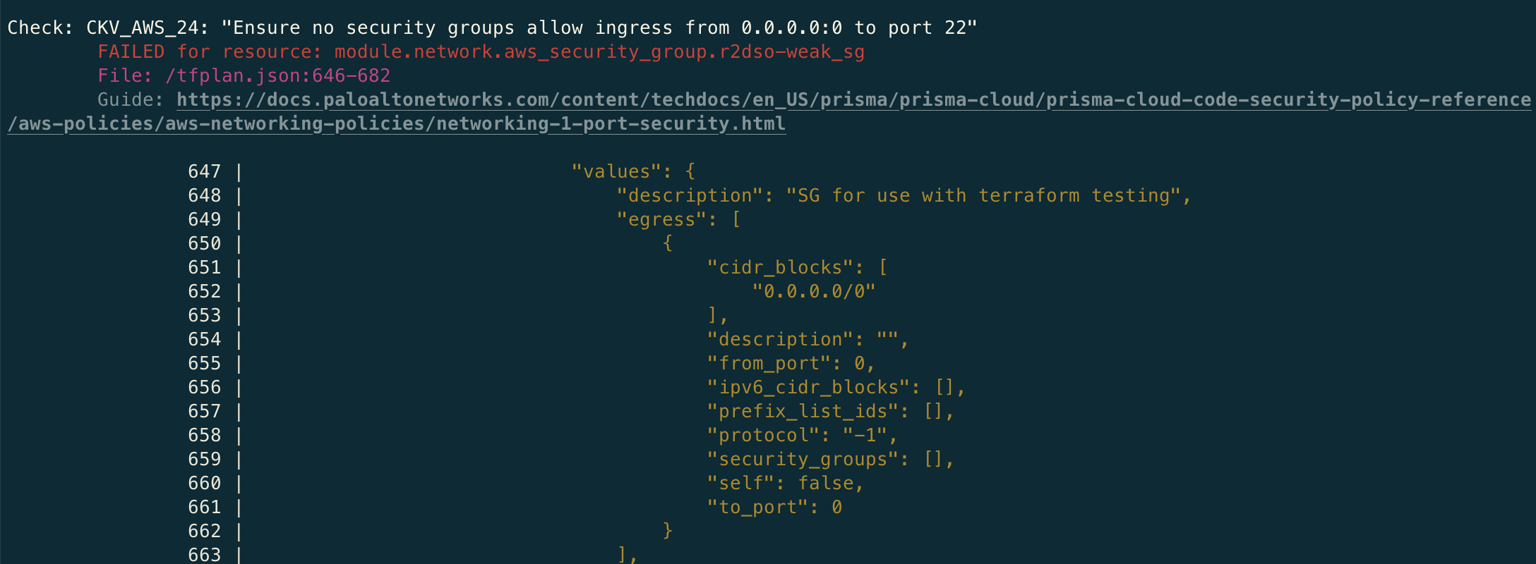
OOB Tooling
tfsec
checkov
terrascan

Slide 51
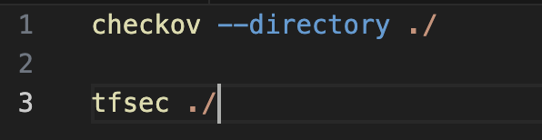
LAB 7 – OOB Scanning
tfsec
https://github.com/aquasecurity/tfsec
Run tfsec
checkov
https://www.checkov.io/2.Basics/Installing%20Checkov.html
Run checkov
Notes:
https://gist.github.com/mccabe615/c5e631fa766697eaaf98020bc1ee10ba

Slide 52
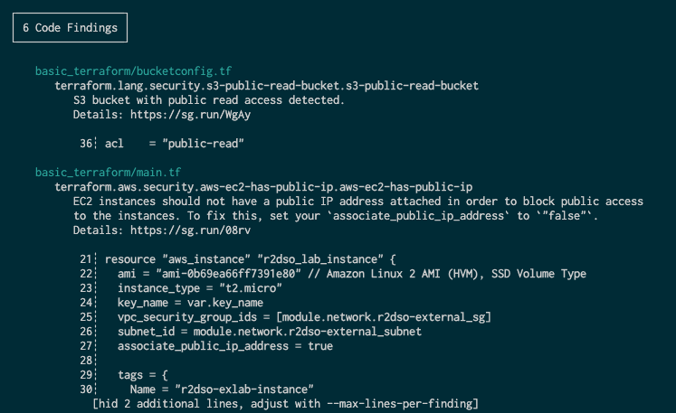
SEMGREP – SAST in Infra as Code
semgrep – Semantic grep

Slide 53
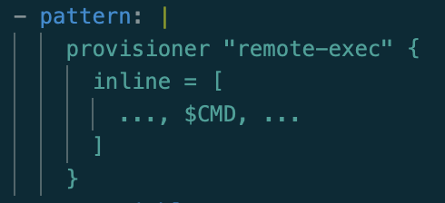
SEMGREP basics
(…)
Patterns
Fundamental ”skip stuff” thing
Can be 0 or more
Confuses everyone at some point
Careful with multiple …, …
Building block of patterns
Define what you want to match
Building block of rules
“ | “ is simply indicating multi-line

Slide 54
SEMGREP basics
Metavariables
Pattern Variations
The capture group of Semgrep
Track values across code scope
Must be found
AND by default (multiple `pattern`)
pattern-either == OR
pattern-not excludes results
pattern-inside reduces scope
focus-metavariable == Waldo’s hat

Slide 55


SEMGREP basics | pattern:
metavariable
focus-metavariable
$WALDO | $WALLY

Slide 56
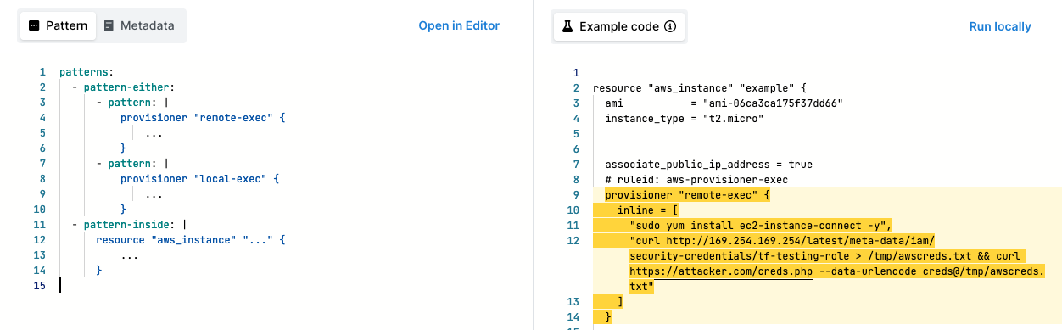
SEMGREP – SAST in Infra as Code
semgrep – the default rules

Slide 57
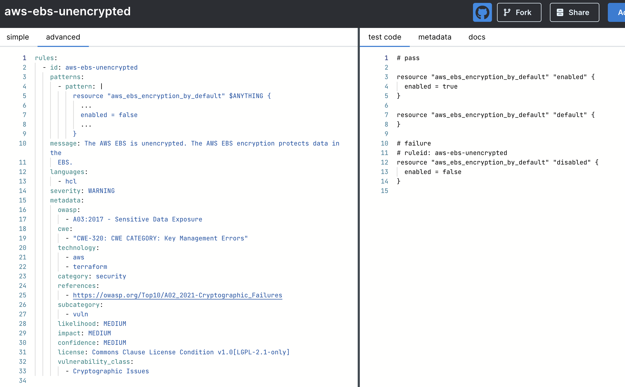
SEMGREP – AWS Security

Slide 58
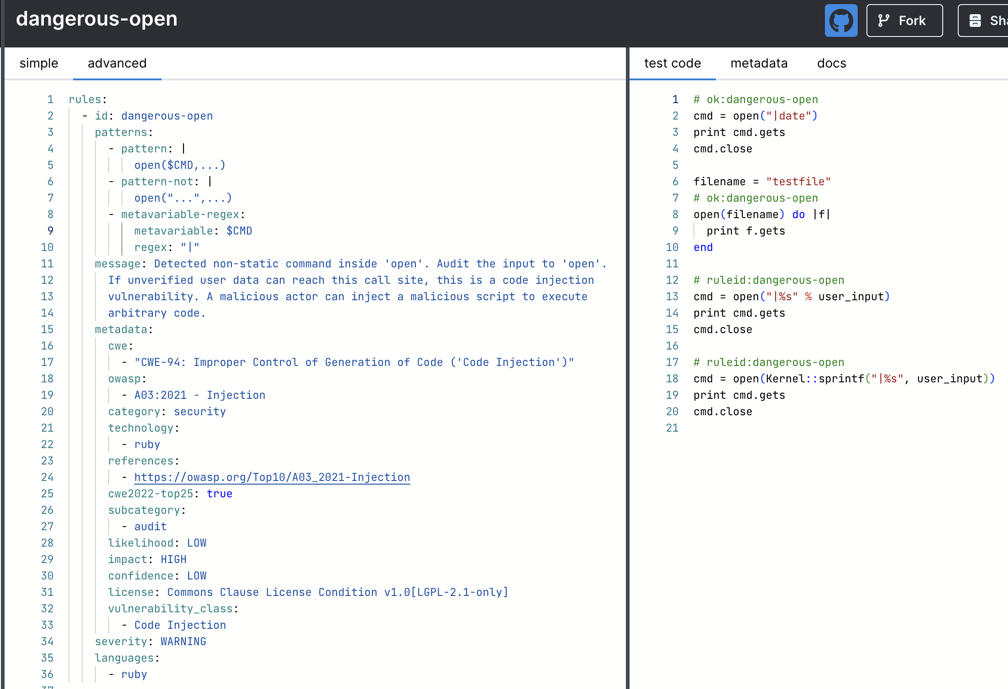
SEMGREP – any filetype

Slide 59
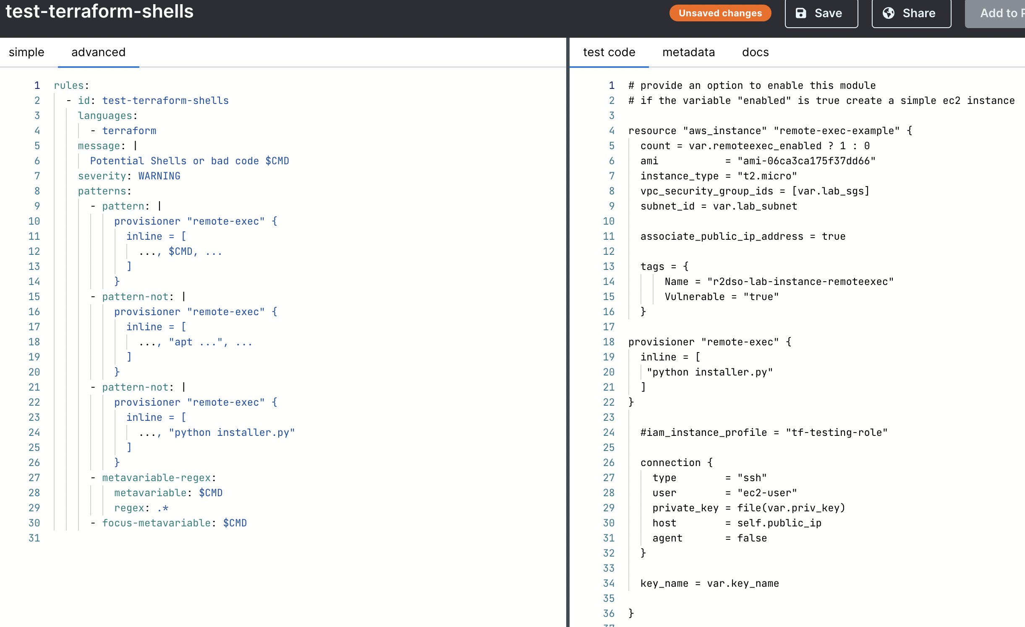
SEMGREP – Custom Rules

Slide 60
LAB 5 – AWS Account Takeover
Notes:
https://gist.github.com/mccabe615/c5e631fa766697eaaf98020bc1ee10ba

Slide 61

THANKS! Q&A + Discussion

Slide 62

DAY 2!!

Slide 63

AGENDA – Day 2
Recap
Lab Warm up
SAST
Lab 1
Break

Slide 64
Recap
Providers
Variables
Data sources
Resources
Commands
State

Slide 65
Leveling Up
Undoing Annoyance of repeated input with TFVARS – DEMO
Auto-apply (please don’t do this) - DEMO

Slide 66
LAB 6 – Leveling Up Demos
Notes:
https://gist.github.com/mccabe615/c5e631fa766697eaaf98020bc1ee10ba

Slide 67
Reviewing the project
What are some areas of weakness?
Are there any vulnerabilities in the codebase?
What issues would it introduce?

Slide 68
Pillars of Defense
SAST
Policy as Code
Monitoring
Tooling that scans IaC before the plan / apply
Runs on raw code
Runs on your configuration
Runs on output of the plan
Provides test coverage for your IaC
Enforces policies for an organization
Applied after the plan and before deployment
Runs after deployment
Enforces policies
Last defense
Incident Response

Slide 69
SAST in Infra as Code
Scanning for flaws in the code
Looking for common weaknesses and low-hanging fruit
Custom rules for your environment
Pre-deployment protection
Non-dynamic

Slide 70
OOB Tooling
tfsec
checkov
terrascan

Slide 71
LAB 7 – OOB Scanning
tfsec
https://github.com/aquasecurity/tfsec
Run tfsec
checkov
https://www.checkov.io/2.Basics/Installing%20Checkov.html
Run checkov
Notes:
https://gist.github.com/mccabe615/c5e631fa766697eaaf98020bc1ee10ba

Slide 72
SEMGREP – SAST in Infra as Code
semgrep – Semantic grep

Slide 73
SEMGREP basics
(…)
Patterns
Fundamental ”skip stuff” thing
Can be 0 or more
Confuses everyone at some point
Careful with multiple …, …
Building block of patterns
Define what you want to match
Building block of rules
“ | “ is simply indicating multi-line

Slide 74
SEMGREP basics
Metavariables
Pattern Variations
The capture group of Semgrep
Track values across code scope
Must be found
AND by default (multiple `pattern`)
pattern-either == OR
pattern-not excludes results
pattern-inside reduces scope
focus-metavariable == Waldo’s hat

Slide 75
SEMGREP basics | pattern:
metavariable
focus-metavariable
$WALDO | $WALLY

Slide 76
SEMGREP – SAST in Infra as Code
semgrep – the default rules

Slide 77
SEMGREP – AWS Security

Slide 78
SEMGREP – any filetype

Slide 79
SEMGREP – Custom Rules

Slide 80
LAB 8 – Semgrep Walkthrough
https://semgrep.dev/learn/basics/1
https://semgrep.dev/learn/composition/1

Slide 81
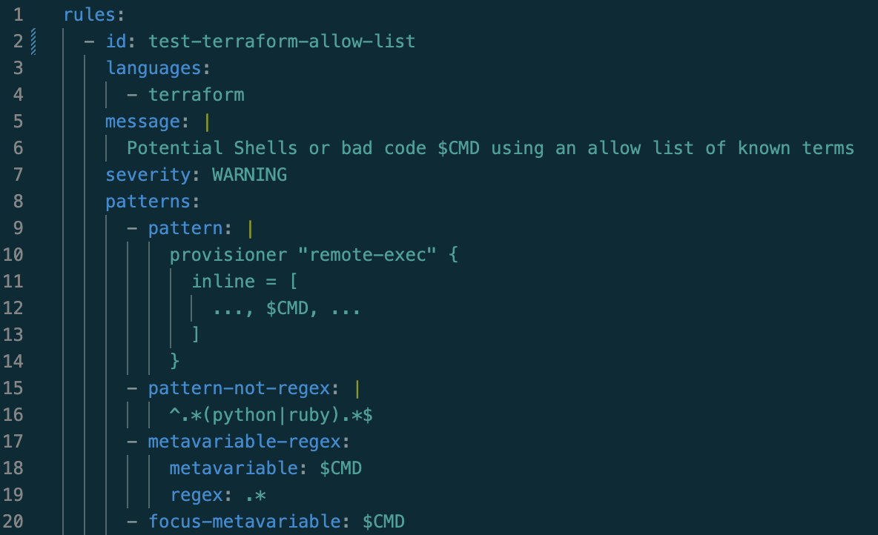
LAB 9 – Custom Rules

Slide 82



Policy as Code – Unit Testing for IaC
Sentinel
Open Policy Agent (OPA)

Slide 83
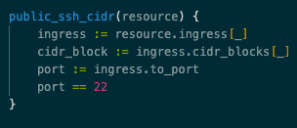
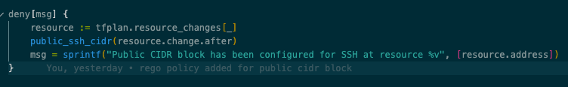
OPA basics - REGO
Rules
Iteration :=
Basic building blocks
Allow / Deny
Break apart arrays and assign values

Slide 84
OPA basics - REGO
opa command
Results
eval
--data <policy>
--input <plan.json>
rule reference
Simple Array
Must rebuild plan for new run

Slide 85
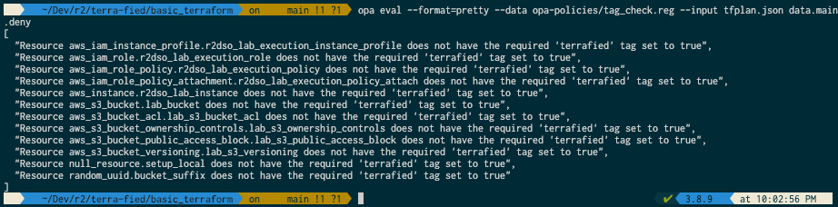
OPA – Checking Tags

Slide 86
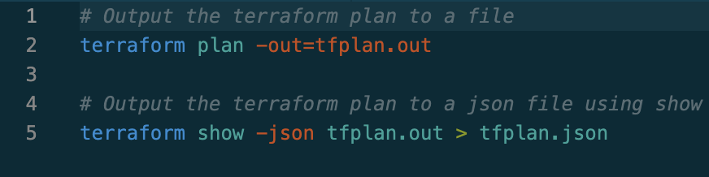
LAB 10 – Let’s run OPA
Can you make these policies better?
What Policy will you write?

Slide 87
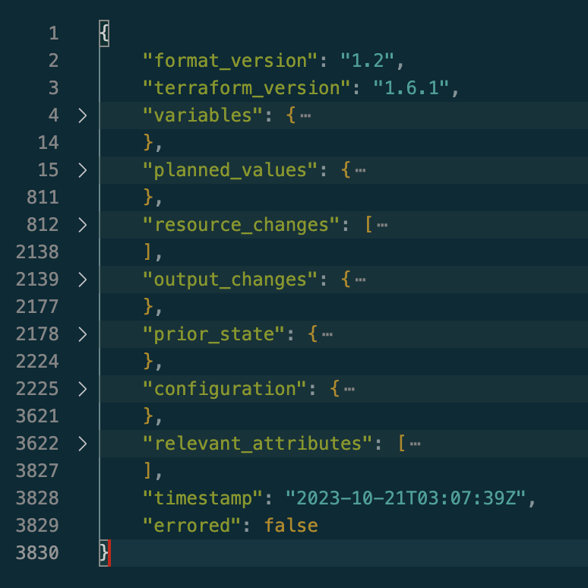
LAB 10 – Examining the plan

Slide 88
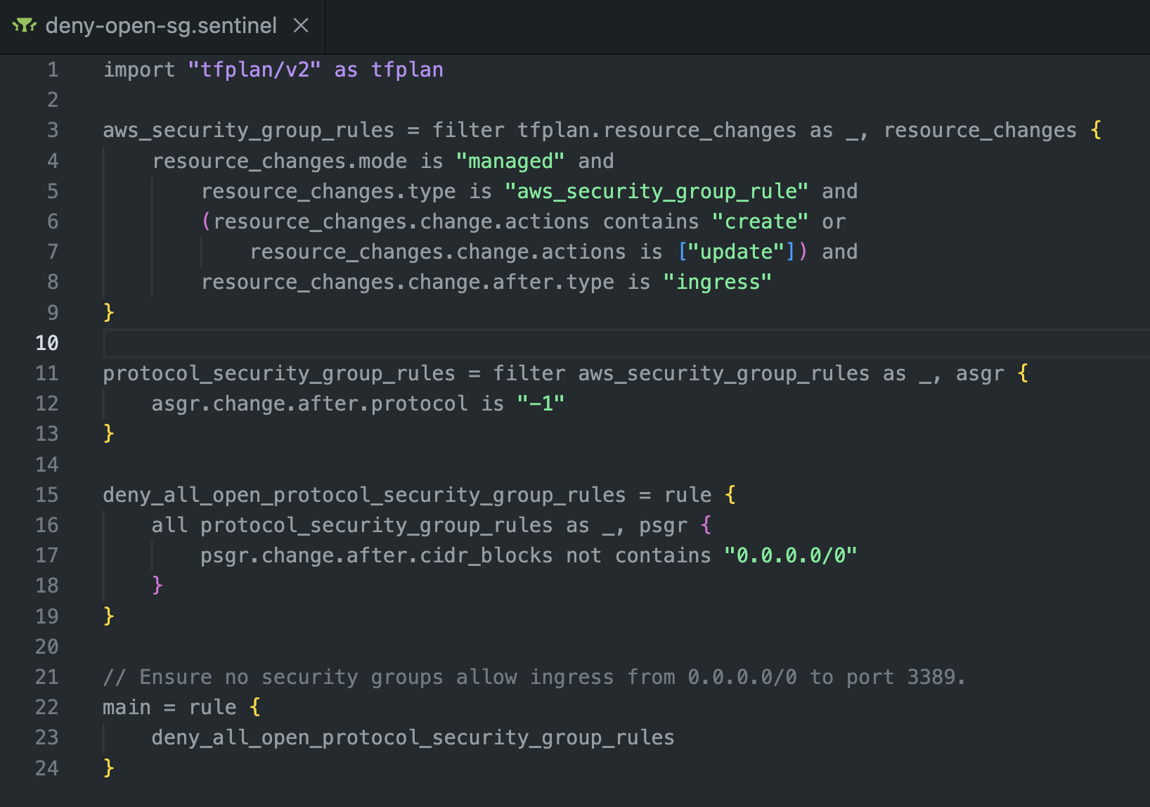
Hashicorp Sentinel

Slide 89
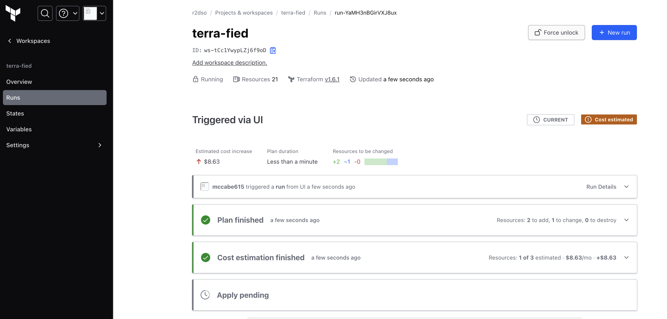
Terraform Cloud

Slide 90
LAB 9 – Terraform Cloud

Slide 91
Terraform After Unknowns
Unknown values are generated at apply time
Terraform puts in temporary values
If security controls are between plan and apply gaps can exist

Slide 92
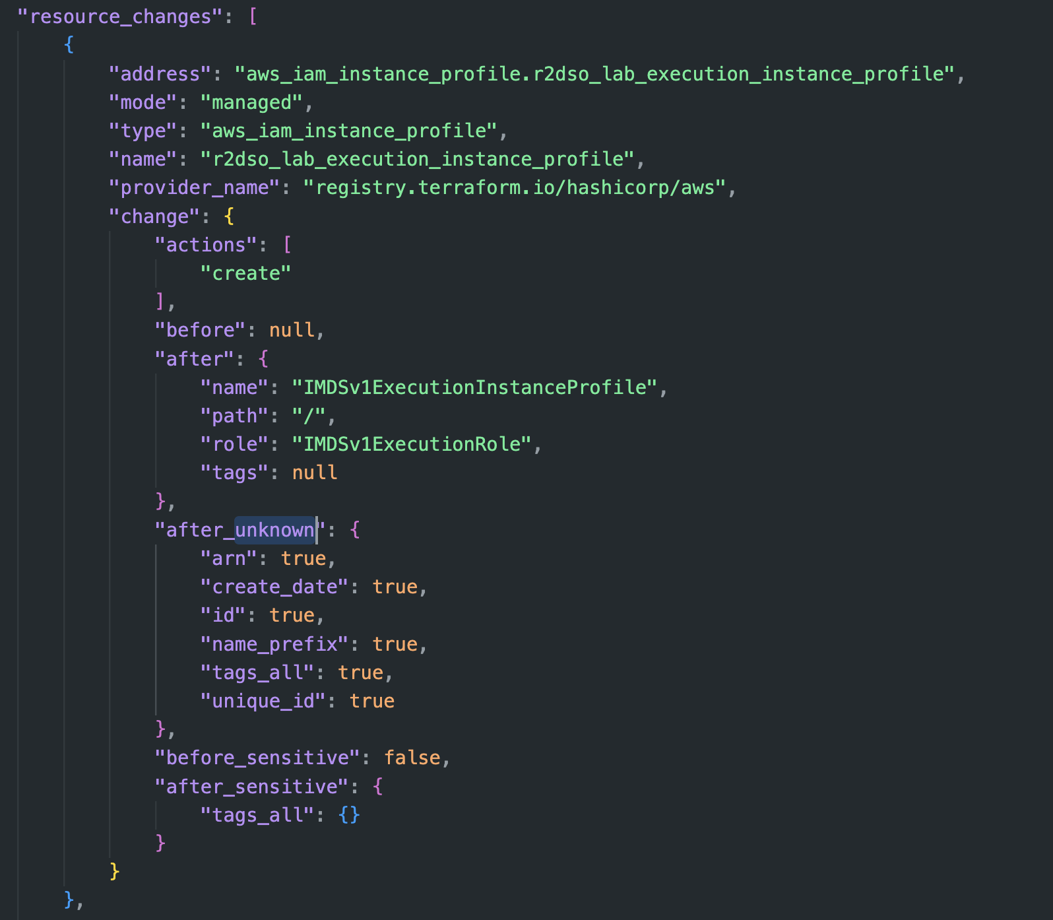
Terraform After Unknowns

Slide 93




Slide 94

Thank You

